Slide 1

Weather Station
Module
Ranajoy Dutta

Slide 2
Contents
Title | Page
Introduction | 3
Hardware Required | 4
Description | 5
DHT-11 Sensor | 6
Technical Parameters of DHT-11 | 7
GPS Expansion | 8
Technical parameters of GPS Expansion | 9
Circuit Diagram | 10
Software Installation in Omega | 11
Software Installation in Server | 12
Running the system | 13

Slide 3
Weather Station
Automated Weather station is an wireless and automated module which will provide the humidity and temperature around the module.
The module also provides the geolocation, i.e. the Latitude and the Longitude of the location where the system is installed.
All these data are sent over cloud to the database and stored there for further analysis, if required.
This system can be scaled if we use multiple such modules over many places so that we can get the weather data from various locations for better analysis.

Slide 4
Hardware requirements
Onion Omega 2+
Expansion Dock
Wires
GPS Expansion
DHT-11 sensor (3-pin)
Power Supply

Slide 5
Description
We are going to build a system that uses sensor to detect the temperature and humidity.
Another hardware is being used to get the Location(Lat & Lng) of the system(sensor).
The data received by Micro-controller from these sensors will be then sent over cloud to the database in regular intervals.
On the other side, a system/server/listener will be ready to receive this data from cloud, save it to database and show to the client when requested over any web browser.

Slide 6
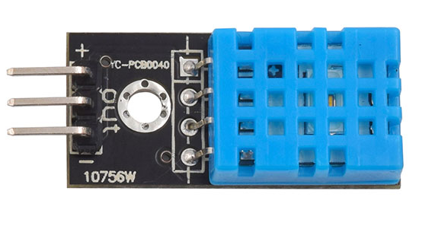
DHT-11 Sensor
The DHT11 is a basic, ultra low-cost digital temperature and humidity sensor. It uses a capacitive humidity sensor and a thermistor to measure the surrounding air, and spits out a digital signal on the data pin. It generates calibrated digital output. Its fairly simple to use, but requires careful timing to grab data. It may take upto 2 minutes to provide the output.

Slide 7
Technical Details
Electrical Parameters | HC-SR04 Ultrasonic Module
Operating Voltage | DC-3.3V or 5V
Operating Current | 0.5-2.5 mA
Sampling interval | 1 Sec
Measurement range | 20-95%RH；0-50℃
Accuracy(Humidity) | ± 5%
Accuracy(Temperature) | ± 2°C
Notes:
https://www.itead.cc/wiki/DHT11_Humidity_Temperature_Sensor_Brick

Slide 8
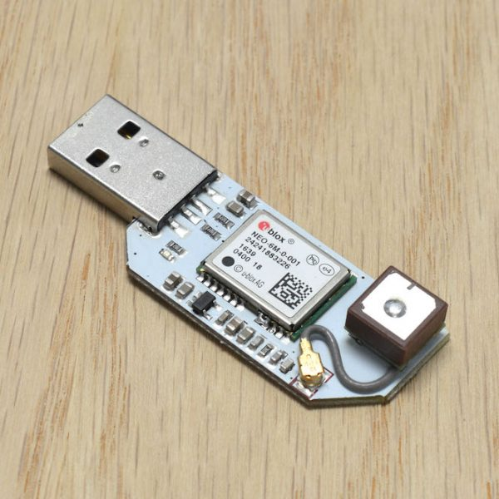
GPS Expansion
The GPS Expansion for the Onion Omega is a USB-based expansion that allows your Omega to pinpoint its location using both GPS as well as China’s Beidou satellite positioning systems. It comes with an on-board GPS antenna as well as a built-in u.FL connector to attach your own antenna. Provides up to 1.8m accuracy, 66 search channels, 22 tracking channels, and -165 dBM sensitivity. Up to 10Hz update rate.

Slide 9
Technical Details
Electrical Parameters | HC-SR04 Ultrasonic Module
Accuracy | 1.8 m
Search Channels | 66
Tracking Channels | 22
Update Rate | 10 Hz
Sensitivity | -165dBM
Notes:
https://www.itead.cc/wiki/DHT11_Humidity_Temperature_Sensor_Brick

Slide 10
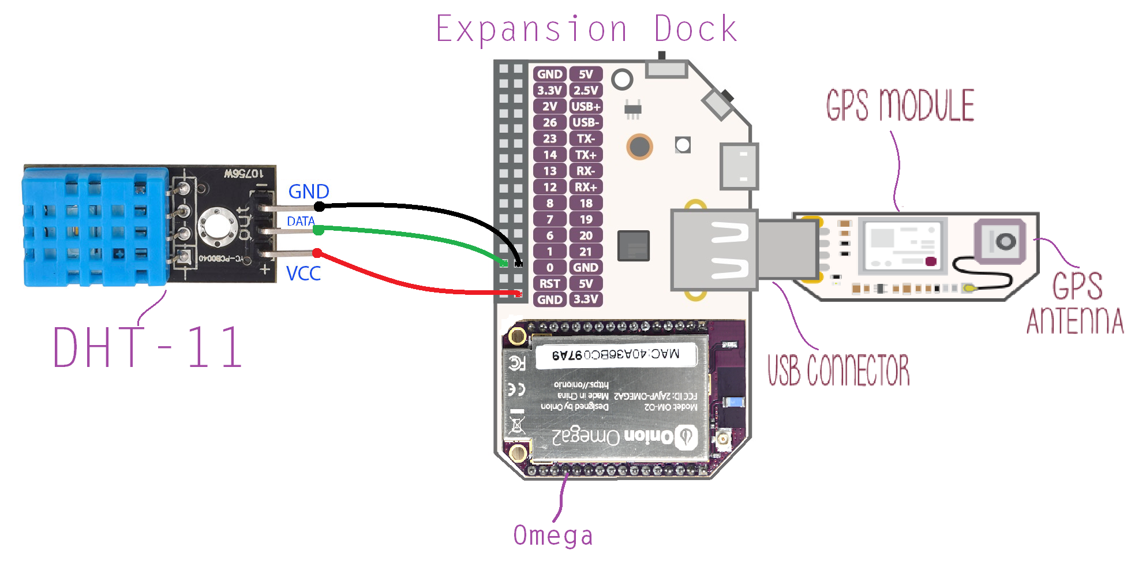
Circuit Diagram

Slide 11
Software installations in Omega
Follow this link for first time setup of Omega - https://docs.onion.io/omega2-docs/first-time-setup.html
Once you are ready, type the following commands :-
opkg update
opkg install python pyOnionGpio
opkg install python-pip
pip install paho-mqtt
Opkg install dht-sensor
Download the sender.py file from https://github.com/ranajoy-dutta/IoT-MQTT.git

Slide 12
Software installations in Server/Your system
**Currently, we are creating our system as a Server. We can also host this server file over cloud service providers like AWS (that supports python and web socket).**
Install Python3 on your system - https://www.python.org/downloads/ (Make sure you have set environment variable for python.)
Create a folder ‘weather_station’ and access it using CMD.
Run command –
pip install flask flask-mqtt flask-socketio eventlet
Clone the required files from github - https://github.com/ranajoy-dutta/IoT-MQTT.git
Open the cloned folder, copy all its files to your ‘weather_station’ folder. You can access the database file using ‘sqlite browser’.

Slide 13
Running Complete system
**Note :- Before running the sender file, You may need to wait for few minutes till the GPS creates a stable connection with the satellite. You can check if it has made a successful connection with satellite by using – ubus call gps info in the terminal. Also, you may need to place the gps sensor on some open space like near to a window for a better connection. Once the connection has been established with the satellite, You may bring it inside.
Once the GPS is fixed with satellite, run the sender.py file in Omega using terminal.
On the other side, run the reciever.py file on the system from ‘weather_station’ folder in your system.
Make sure both omega and your system have active internet connection. Open ‘localhost:5000’ in your browser. Now you should see the new values coming from the hardware module to your web browser.

Slide 14
Thank You !
Contact US
Nitin Sinha
nitin.sinha@goSigmaWay.com
+1 727-394-4375
+91 7838188809
Debjani Mitra
debjani.mitra@goSigmaWay.com
+1 952-583-3449
+91 9339555636
Ranajoy Dutta
ranajoydutta7@gmail.com
+91 9971807197

